Slide 1
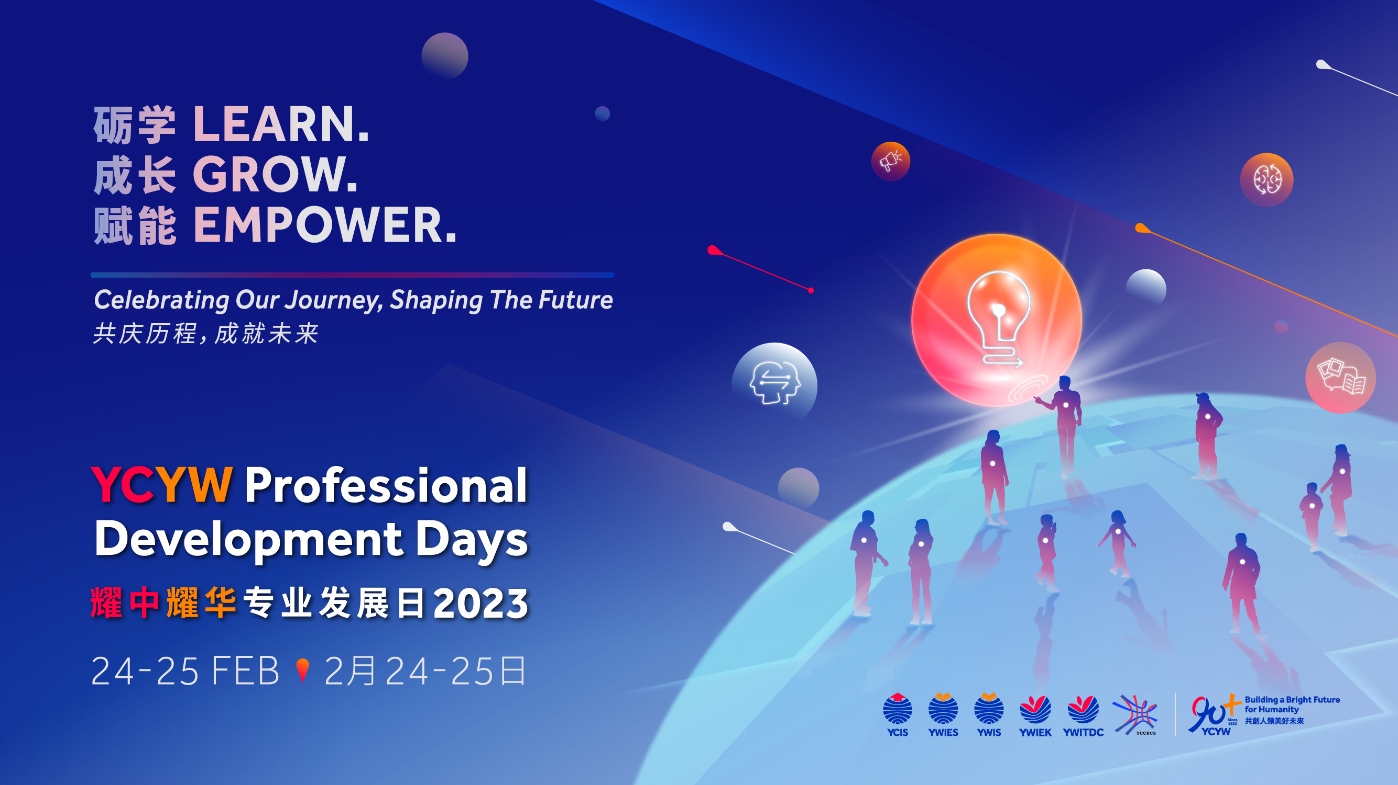
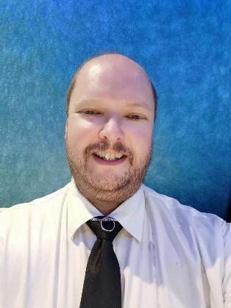
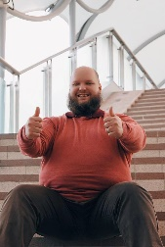
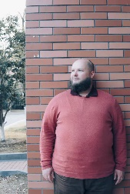
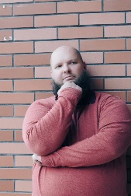
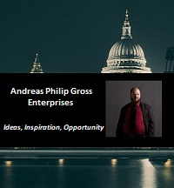
The Ecology of Goal Setting
with Andreas Gross
International Educator, Success Coach,
Small Business Owner and Freelancer
Andreas Philip Gross Enterprises LLC
www.apg-enterprises.com
Email:
admin@apg-enterprises.com
WeChat ID:
thefutureiscoming
Facebook: https://www.facebook.com/apgrossenterprises/

Slide 2
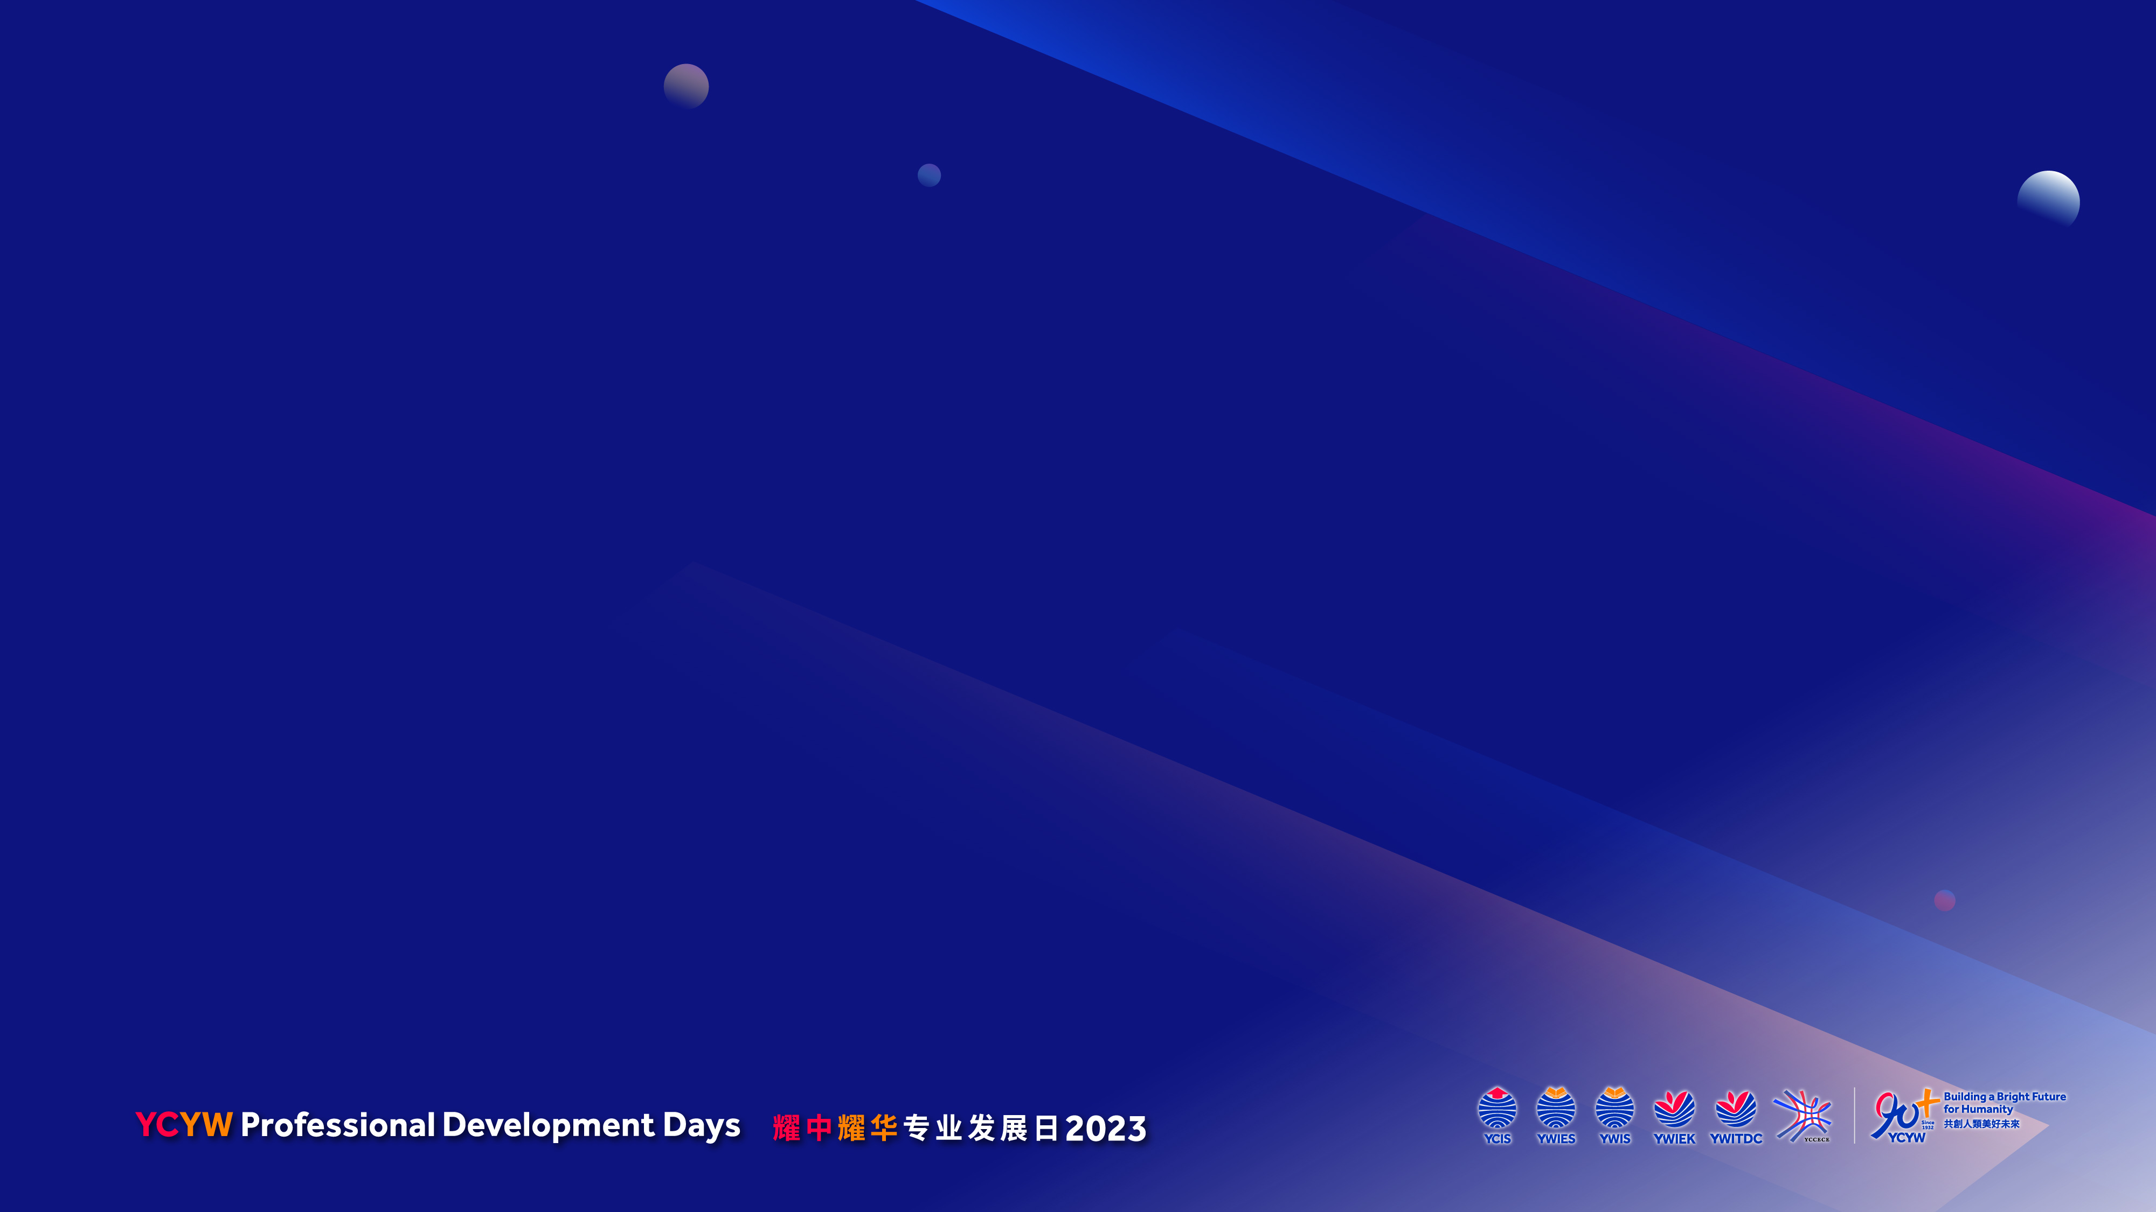
Webinar Outline
Who Am I?
Brief Background on Goal Setting – what is it and why is it important?
What is “ecology” and how does it apply to goal setting?
Why should a goal be “ecological” and how does this all connect to “Celebrating Our Journey, Shaping The Future”?
Closing Remarks

Slide 3
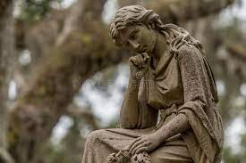
Before we start…..
I’d like to ask us all to:
“Think about a time when you set a goal, ACTUALLY FOLLOWED THROUGH WITH IT (or at least gave it a real, honest attempt), and then found that the path to achieving the goal, or the outcome of the goal itself, came with consequences (either positive or negative) you hadn’t anticipated.”
We’ll share this later.

Slide 4
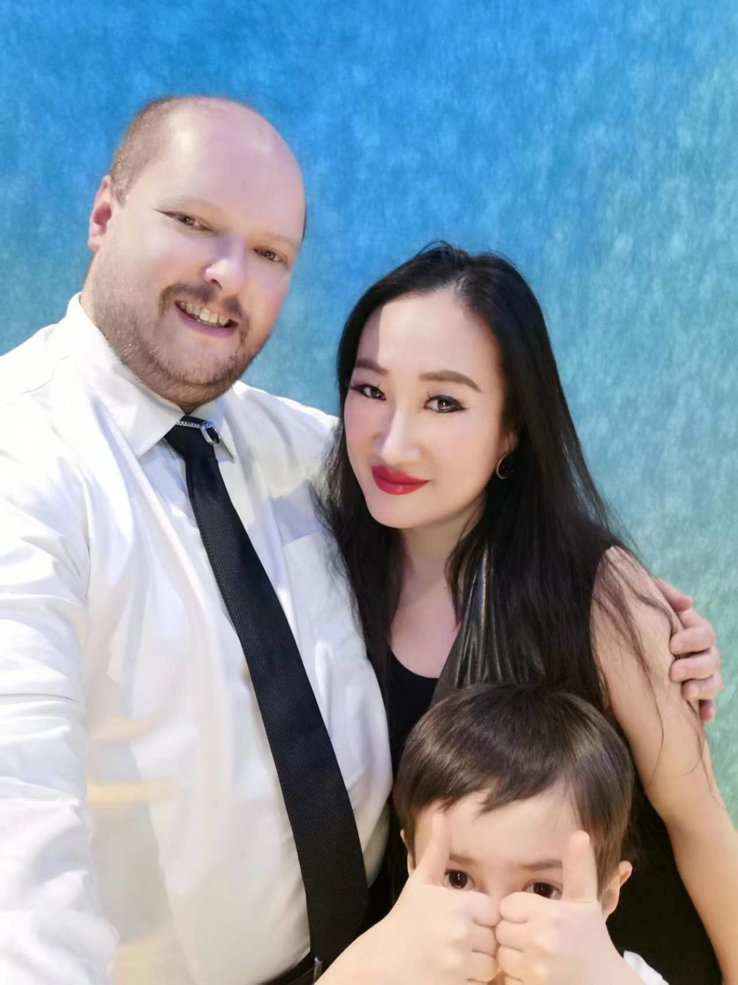
Who Am I?
I am an elementary school educator with 15 years of experience in the classroom (November 30, 2022, was my “15 Year Anniversary in the Classroom”). Ten and a half of those years have also included leadership responsibilities which saw me wearing the hats of Head of Department, Team Leader, and Coordinator at various times throughout that period. I am also an International Coaching Federation (ICF) trained coach. My field is success coaching. I partner with people of all ages looking for clarity around major career and educational decisions in their lives. I have three children (oldest son pictured here) and am married to a wonderful woman, a fellow educator (also pictured here). We met when I was teaching in Shanghai during my “first stint” in China between 2012-2015. I’m originally from Washington State, USA, although I’ve lived in quite a few different places since childhood, considering my own mother was also an international school teacher. I currently live in Kunshan, China, where my wife and I are, once again, teaching together at an elementary school.

Slide 5
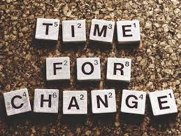
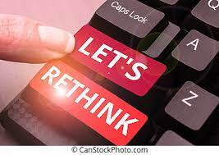
Brief Background on Goal Setting – what is it and why is it important?
When looking at it from the outside, the topic of goal setting can all too frequently seem like a straightforward, no-questions-asked, “plug-and-chug” kind of ordeal – come up with a goal, break it apart into manageable steps, then work through the process of execution one step at a time. And, to be fair, this IS more or less how it works at the most rudimentary level.

Slide 6
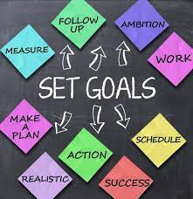
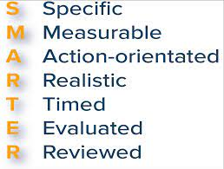
Brief Background on Goal Setting – what is it and why is it important?
I’m sure we’ve all heard of “SMART” Goals, or maybe even “SMARTER” Goals
SMART =
Specific, Measurable, Attainable/Action-oriented, Relevant, and Time-Bound
SMARTER =
Specific, Measurable, Attainable/Action-oriented, Relevant, Time-Bound, Evaluate, and Re-examine/Readjust

Slide 7
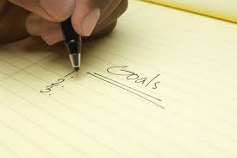
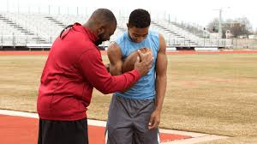

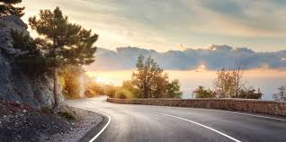
Brief Background on Goal Setting – what is it and why is it important?
If you’ve done, or even attempted to do, any kind of serious, disciplined goal setting before (I’d guess this applies to many – if not all – of us here) you may have worked with a coach, teacher, or mentor; done it on your own with the plethora of DIY goal setting information out there; or maybe a little bit of each or some of these things.

Slide 8
Brief Background on Goal Setting – what is it and why is it important?
A quick Internet search on
“goal setting”
turns up over 1 billion hits in less than a minute!

Slide 9
Brief Background on Goal Setting – what is it and why is it important?
The point is: there are plenty of resources and informational guides out there on the mechanics of making, setting, and sticking to good, solid goals, and that’s good and necessary. Everyone needs some kind of goal or goals to be working towards in life in order to experience growth and development. Goals and their achievement in life are, in fact, NECESSARY for a good, whole, full life.
So, while setting goals the right way, for the right reasons, and following through with achieving those goals is GREAT for sure, the steps and mechanics of “How to set a good goal and stick to it” is not what this webinar is about.

Slide 10
What is “ecology” and how does it apply to goal setting?
“Ecology” (noun)
Let’s go ahead and share some ideas about this in the chat.
What is it? What does it mean?

Slide 11
What is “ecology” and how does it apply to goal setting?
“Ecology” (noun)
From: https://www.merriam-webster.com/dictionary/ecology
1: a branch of science concerned with the interrelationship of organisms and their environments
2: the totality or pattern of relations between organisms and their environment
3: HUMAN ECOLOGY
4: ENVIRONMENT, CLIMATE
ex. the moral ecology
also : an often delicate or intricate system or complex
ex. the ecology of language
Today we are looking at these definitions of the word “ecology”.

Slide 12
Think about a time when you set a goal, ACTUALLY FOLLOWED THROUGH WITH IT, and then found that the outcome of the goal came with consequences (either positive or negative) you hadn’t anticipated.
We’ll take a minute to think
about this and share in the chat.
Pause for the Cause!

Slide 13
What is “ecology” and how does it apply to goal setting?
In order for a goal to truly be optimally achieved, and for that achievement to have deep and lasting effects:
the totality or pattern of relations between organisms (i.e. all relevant players and parties) and their environment – which is often a delicate intricate system or complex – should be harmonious and in-line with the goal in question and conducive to the processes, effects, and outcomes of the goal as much as possible. The more conducive the whole ecology is to allowing the goal to be followed through with and achieved, the more likely it is that the goal will be achieved and will result in lasting results.
“Ecology” (noun)
From: https://www.merriam-webster.com/dictionary/ecology
1: a branch of science concerned with the interrelationship of organisms and their environments
2: the totality or pattern of relations between organisms and their environment
3: HUMAN ECOLOGY (link)
4: ENVIRONMENT, CLIMATE
ex. the moral ecology
also : an often delicate or intricate system or complex
ex. the ecology of language

Slide 14
What is “ecology” and how does it apply to goal setting?
“ECOLOGY” can encompass a lot of things.
There are articles and entire chapters in books dedicated to just this. There are coaches and mentors who focus on this topic for their careers. It is limiting to say “ECOLOGY” (in relation to goal setting) can just be “boiled down” to a handful of factors…but we also have realistic limits of what we can talk about today, so we are going to look at these big four factors to start off with:
Time in your life in relationship to your own education/abilities/skillset and your own chronological age
Time in your life in relationship to those around you
Where you live
Your network

Slide 15
What is “ecology” and how does it apply to goal setting?
Let’s look at these things through an example and see how they tie into celebrating our journey and shaping the future.

Slide 16
Why should a goal be “ecological” and how does this all
connect to “Celebrating Our Journey, Shaping The Future”?
When making a goal and starting to think about goal ecology:
What are both the immediate and far-reaching consequences of that goal and are those consequences in line with and true to yourself and the path you want your own personal journey to follow in this life? What is the “ripple effect” of your goal? And what may be some “ripples” either standing in the way of, or standing at the ready to help you achieve your goal? The goal may be a good goal, but are the time and place right for this goal right now? Are YOU ready for this goal right now?

Slide 17
Why should a goal be “ecological” and how does this all
connect to “Celebrating Our Journey, Shaping The Future”?
The question changes from “Is this a good, solid ‘SMART’ or ‘SMARTER’ goal that I can honestly work through and achieve?”
TO
(Let’s assume that, yes, it is a good goal) “Is this the RIGHT goal for me RIGHT NOW based on who I currently am, where I currently am, and what I currently know and can do?”

Slide 18
Why should a goal be “ecological” and how does this all
connect to “Celebrating Our Journey, Shaping The Future”?
Let’s walk through an example to help illustrate these things:
Example
You (think you) want to open your own business.

Slide 19
Why should a goal be “ecological” and how does this all
connect to “Celebrating Our Journey, Shaping The Future”?
Let’s just go ahead and validate this goal right away and say that you have gone through your SMART goal setting process and have “checked all the right boxes” on your goal setting worksheet.

Slide 20
Why should a goal be “ecological” and how does this all
connect to “Celebrating Our Journey, Shaping The Future”?
S – Specific:
You’ve determined all the specifics of what your business will do, how it will operate, what kind of product and/or service it will offer and how it will do that, etc.

Slide 21
Why should a goal be “ecological” and how does this all
connect to “Celebrating Our Journey, Shaping The Future”?
M – Measurable:
You’ve determined exactly how you will measure the success of this goal.

Slide 22
Why should a goal be “ecological” and how does this all
connect to “Celebrating Our Journey, Shaping The Future”?
A – Attainable/Action-oriented:
You’ve determined that this goal is within your reach of achievement and you have come up with specific action steps and a timeline to make this goal a reality.

Slide 23
Why should a goal be “ecological” and how does this all
connect to “Celebrating Our Journey, Shaping The Future”?
R – Relevant:
You’ve determined how this goal is relevant to your wants/needs/desires and how it will be relevant to the world.

Slide 24
Why should a goal be “ecological” and how does this all
connect to “Celebrating Our Journey, Shaping The Future”?
T – Time Bound:
You’ve come up with a step-by-step timeline that you feel you can stick to to work through towards achieving this goal (attainable and time-bound).

Slide 25
Why should a goal be “ecological” and how does this all
connect to “Celebrating Our Journey, Shaping The Future”?
But still….something just doesn’t seem right about it all. You’ve ALWAYS wanted to open your own business, and people have been telling you for years: “Don’t hold back on your dreams!” So, BOOM! Here you are planning to throw open your doors to the business of your dreams – what “doesn’t seem right” about that?

Slide 26
Why should a goal be “ecological” and how does this all connect to “Celebrating Our Journey, Shaping The Future”?
You’ve wanted to do it for years now! This is your life, your journey, and you are in control, right?
RIGHT! If this is the goal you want, and you’re determined to make it happen, then go for it!

Slide 27
Why should a goal be “ecological” and how does this all connect to “Celebrating Our Journey, Shaping The Future”?
WHAT IS THE PROBLEM?
Where are your doubts coming from?

Slide 28
Why should a goal be “ecological” and how does this all connect to “Celebrating Our Journey, Shaping The Future”?
To be fair, your doubts could very well be coming from any number of places, but let’s take a look at the ecology surrounding this goal for our purposes today. This is often a common place where things may “not feel right”.

Slide 29
Why should a goal be “ecological” and how does this all connect to “Celebrating Our Journey, Shaping The Future”?
Is this the right time in your life in relationship to your own chronological age and your current skills and abilities?
  Do you need more education or experience? Some kind of certificate or degree? Do you currently have the necessary skills to do this? Is there an actual chronological age limit to this goal (i.e. the big one that comes to mind for me right now is age restrictions on visas for international work in some countries)

Slide 30
Why should a goal be “ecological” and how does this all connect to “Celebrating Our Journey, Shaping The Future”?
Is this the right time in your life to pursue this goal in relationship to those around you?
  Do you have family commitments? Outstanding debts to payback on other things? Other pre-existing commitments that would get in the way of pursuing this goal right now at this particular point in your life?

Slide 31
Why should a goal be “ecological” and how does this all connect to “Celebrating Our Journey, Shaping The Future”?
Do you physically live in a place where this goal is going to be achievable right now at this current point in time?
  Will your jurisdiction allow you to operate such a business or even open any kind of business at all?

Slide 32
Why should a goal be “ecological” and how does this all connect to “Celebrating Our Journey, Shaping The Future”?
Do you have an existing support network (family, friends, connections) who you can rely on to help create the right environment around you to help you achieve this goal right now at this particular point in your life?

Slide 33
Why should a goal be “ecological” and how does this all connect to “Celebrating Our Journey, Shaping The Future”?
Some other things you might want to think about (short list)….
Are you really the kind of person who would do this? Or did society “plant” this goal in your head?
Will this help YOU or hinder YOU in the long run of your journey?
Will your spouse leave you and your kids hate you for it?
Will you be able to take that yearly fishing trip to Alaska you can’t live without?
Will others around you think differently of you and treat you differently after you open your business?
Will you hate yourself in twenty years for the monster that you’ve become?
How will my life be different – for better or for worse?
How will achieving this goal change, modify, or otherwise affect my current sense of identity?

Slide 34
Why should a goal be “ecological” and how does this all connect to “Celebrating Our Journey, Shaping The Future”?
To sum it all up……
……how MUCH will I have to modify and reroute the course of my own personal journey – how much will I have to change my own personal identity – in order to shape the course of the future where this goal becomes an actual reality?
A lot?
A little?
Do I REALLY WANT TO?

Slide 35
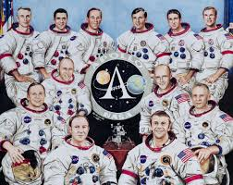
Why should a goal be “ecological” and how does this all connect to “Celebrating Our Journey, Shaping The Future”?
Two sad examples of “unintended consequences”
Apollo Astronauts
1961-1975
U.S. Government program that put the first human beings on the Moon
Of course, they went on to experience world-fame….
….but with that fame also came a whole group of (mostly generally otherwise level-headed) people who called them hoaxsters and ridiculed their “fake Moon landing” for the rest of their lives (and still do).

Slide 36
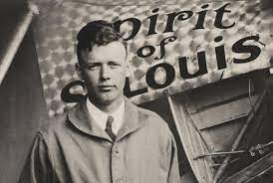
Why should a goal be “ecological” and how does this all connect to “Celebrating Our Journey, Shaping The Future”?
Two sad examples of “unintended consequences”
Charles Lindbergh
1902-1974
World-famous early aviator; in 1927 became the first person to cross the Atlantic Ocean by airplane on a non-stop solo flight
Of course, this brought him personal success (this was a major goal of his in life) and world-fame, and success after success seemed to keep coming to him again and again in life….
….but this fame wound up making him a target, and resulted in his first-born son getting kidnapped and murdered, an event that hung like a dark cloud over him and plagued him for the rest of his life, despite his many successes.

Slide 37
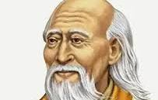
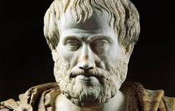
Why should a goal be “ecological” and how does this all connect to “Celebrating Our Journey, Shaping The Future”?
Two happier examples of unintended (maybe…we will never know) consequences/outcomes..........
Laozi
Aristotle
Born c.571BCE
384BCE-322BCE
Both great, “legendary” teachers even in their own lifetimes (life goals of learning and sharing knowledge)….and their journeys are still going on to this day - they are still shaping the future of the world through the legacies they have left behind.

Slide 38
Wrapping things up….
Where does your influence begin?
Where does it end?
How are your current goals and aspirations based on your personal mindset and identity affecting YOUR journey and YOUR future?
How is your journey (and the subsequent future it is destined to have you arrive at) affecting your present goals and aspirations?
How is your current position/situation in life helping and/or hindering you in walking the path you want to and expressing your true identity the way you truly want to express it?

Slide 39
Final Remarks/Closing Thoughts….
The ecology of your goal and the ecology of the environment your goal is trying to manifest itself in have a big impact on how easy or difficult your goal may be to achieve.
It IS possible to have GOOD goals that aren’t the RIGHT goals for you RIGHT NOW because of the ecological reasons.
Goals are rigid but flexible!
- Goals can and do change
- Ecologies and environments can and do change, sometimes
drastically and quickly! What started out as a good goal a the right time
in the right place yesterday may not be so tomorrow.
- It is OK TO REINVENT YOURSELF, but don’t feel like you have to!

Slide 40
Final Remarks/Closing Thoughts….
Who does this apply to?
EVERYONE!
Kids, Adults
Students
Working Professionals
Retirees
Individuals and Organizations

Slide 41
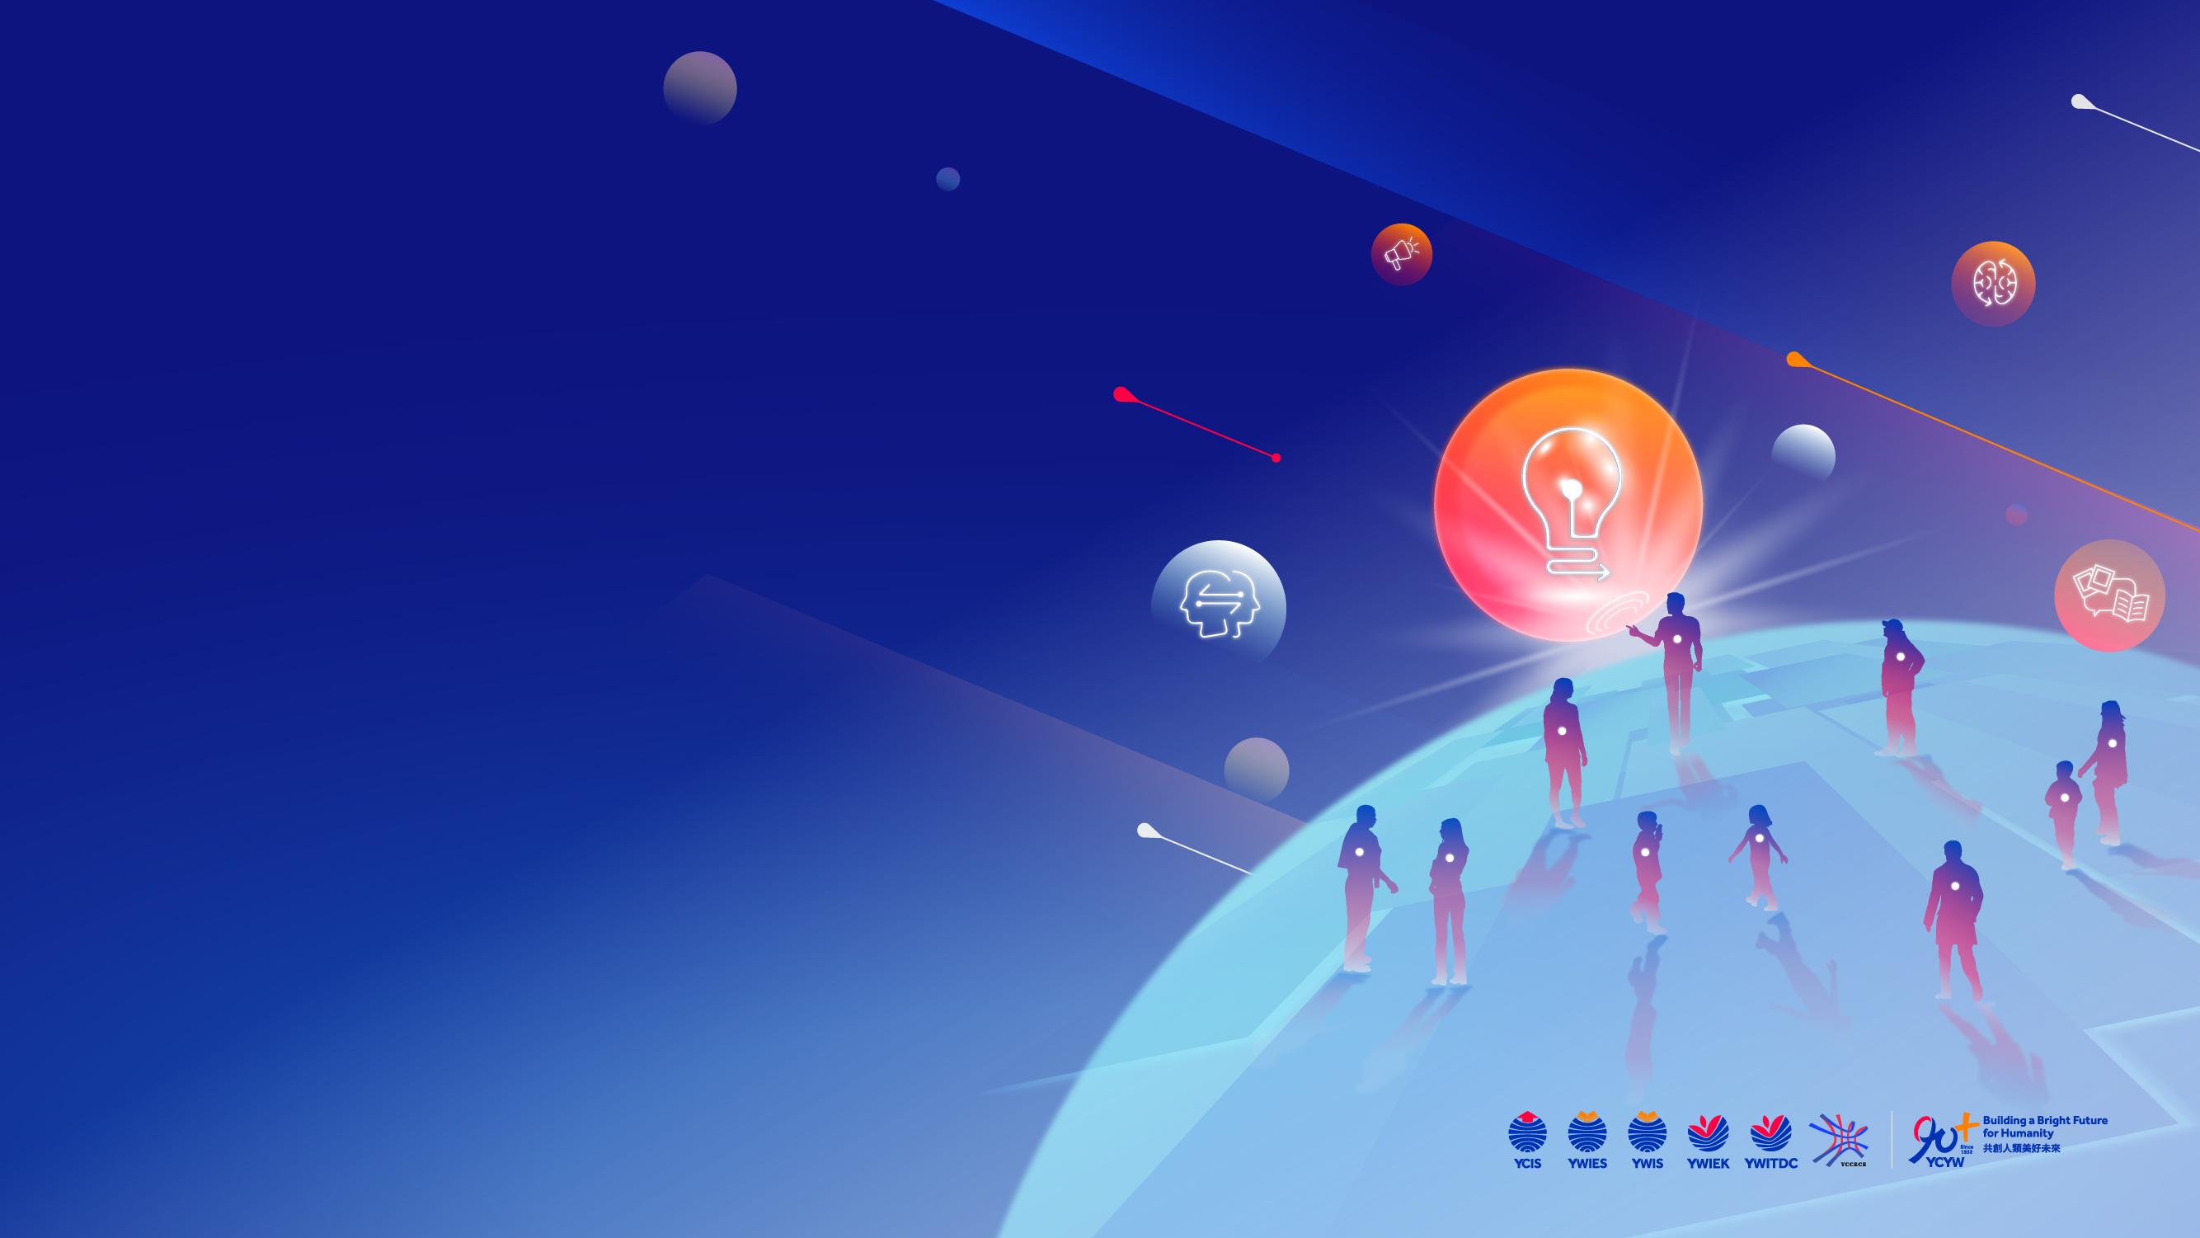
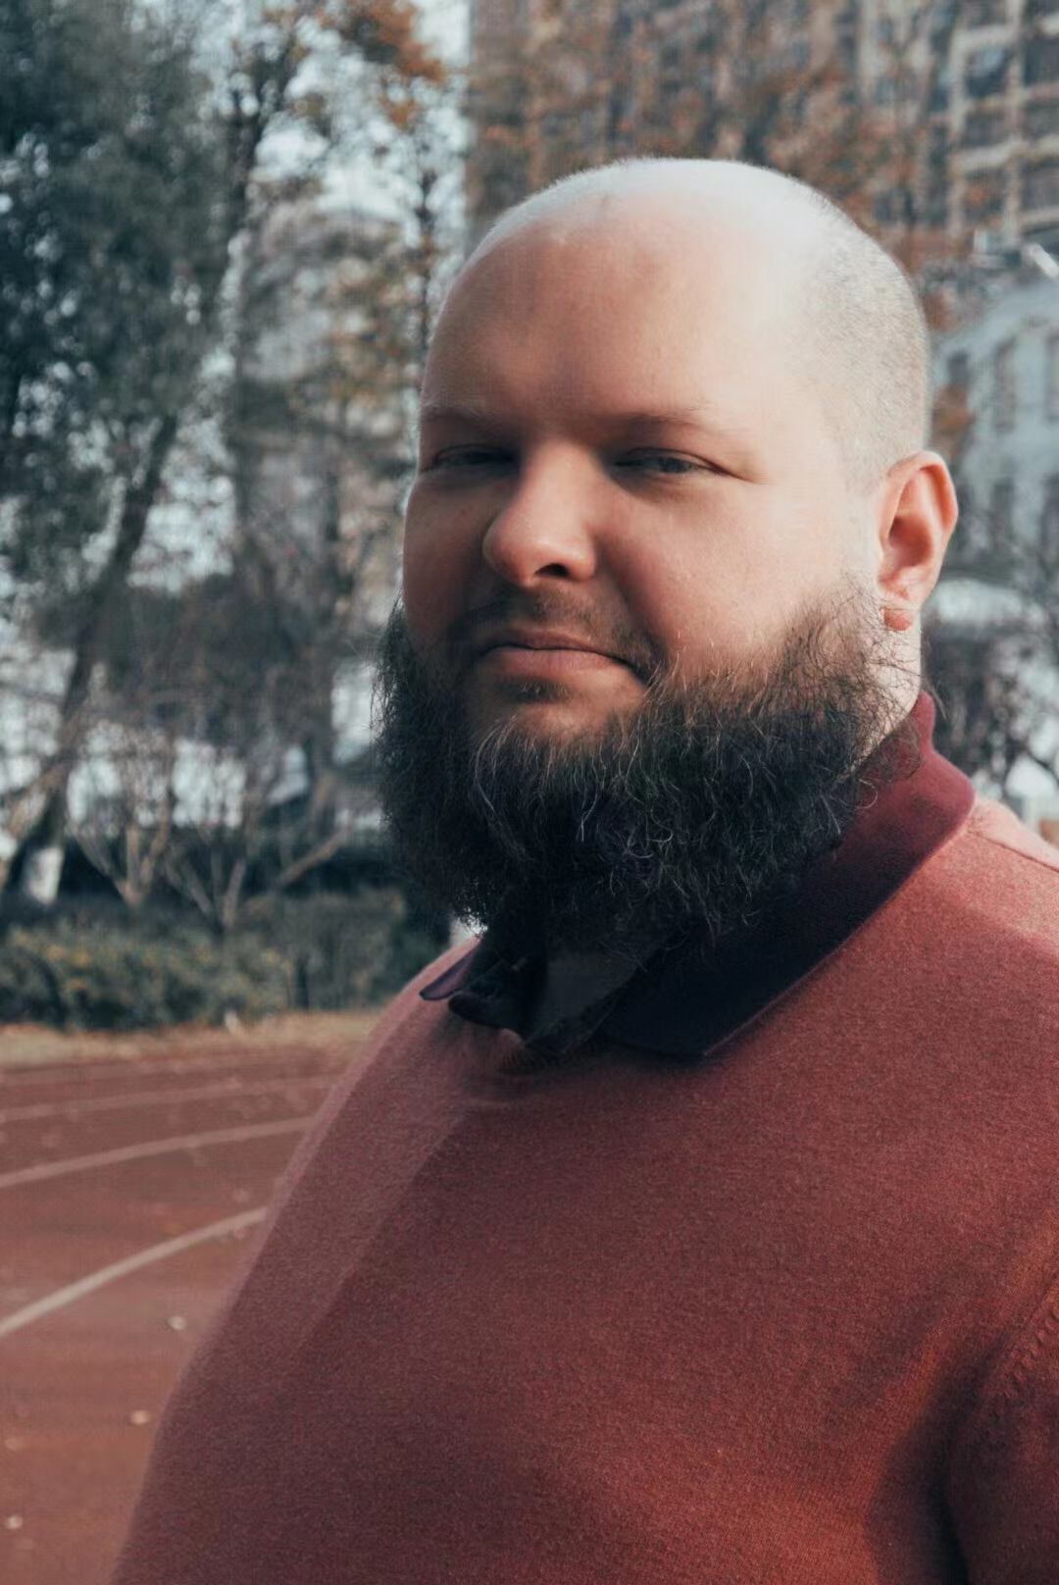
The Ecology of Goal Setting
with Andreas Gross
International Educator, Success Coach,
Small Business Owner and Freelancer
Andreas Philip Gross Enterprises LLC
www.apg-enterprises.com
Email:
admin@apg-enterprises.com
WeChat ID:
thefutureiscoming
Facebook: https://www.facebook.com/apgrossenterprises/
Thank you!

